Slide 1
PARKING SPACE COUNTER
Presented By-
Rishit Gupta
(20BCS1270)

Slide 2
WHAT IS PARKING
SPACE COUNTER
Parking Space Counter is a project that is used to count vehicles entering and exiting a parking facility to determine when the lot is full.

Slide 3
Need of Parking Space Counter
01 02
Finding a Spot
Keeping Track
The parking lot counter keeps track of vehicles using CCTVs introduced at the entrance and exit of each lot.
When you’re managing multiple
parking lot facilities, a multi-lot
parking counter can make the
difference between happy customers and disgruntled drivers searching from lot to lot for somewhere to park.
03
Guiding Parkers
With the parking counter system, you can make sure drivers know when a lot is full and are guided to a lot that isn’t.

Slide 4
Objectives
01
02
03
Monitoring car parking area
Helps to keep track of parking availability data in multiple lots from a single interface.
Provide information
Gives details about how many slots are filled or vacant in a specific number
Reduce traffic in the parking area
Helps drivers save time by telling them about the number of free slots in the parking area and also guides them about the slot number that is vacant.

Slide 5
Project Design
The project is divided into two sub-modules: Picker module and main module
Picker Module Main Module
Collect video
Check the pixels of each rectangle and determine whether the slot is filled or not
Convert into images
Create rectangles around parking slots
Show output

Slide 6
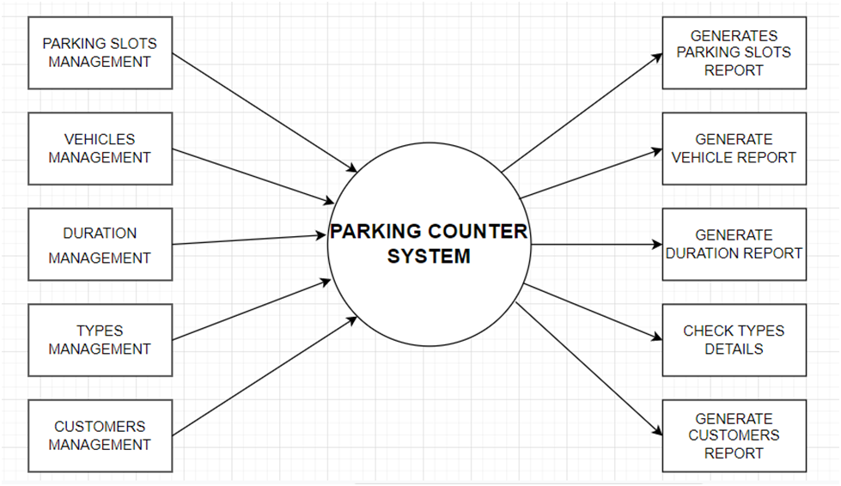
Design (Data Flow Diagram)

Slide 7
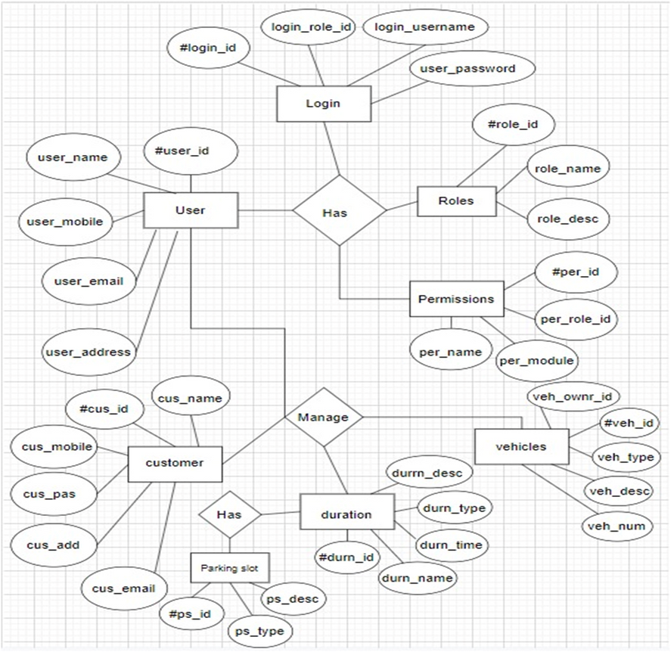
Design (ER Diagram)

Slide 8
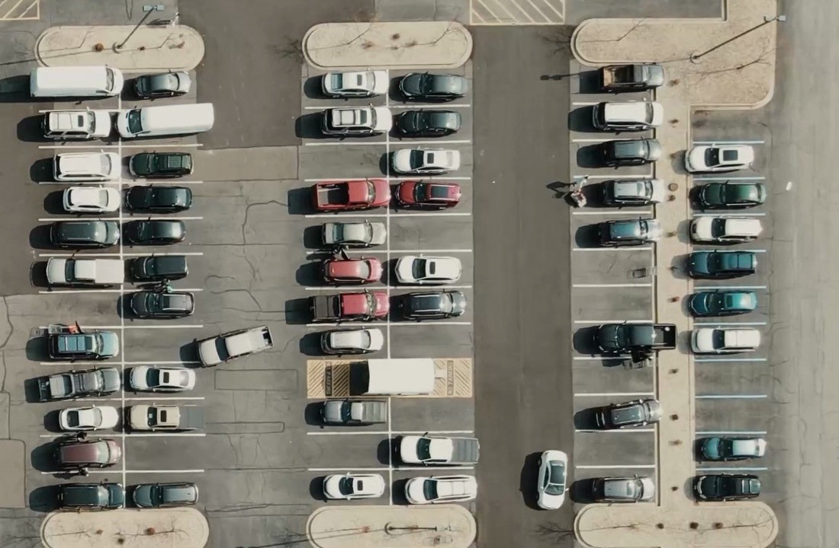
Screenshots
Before (Input):

Slide 9
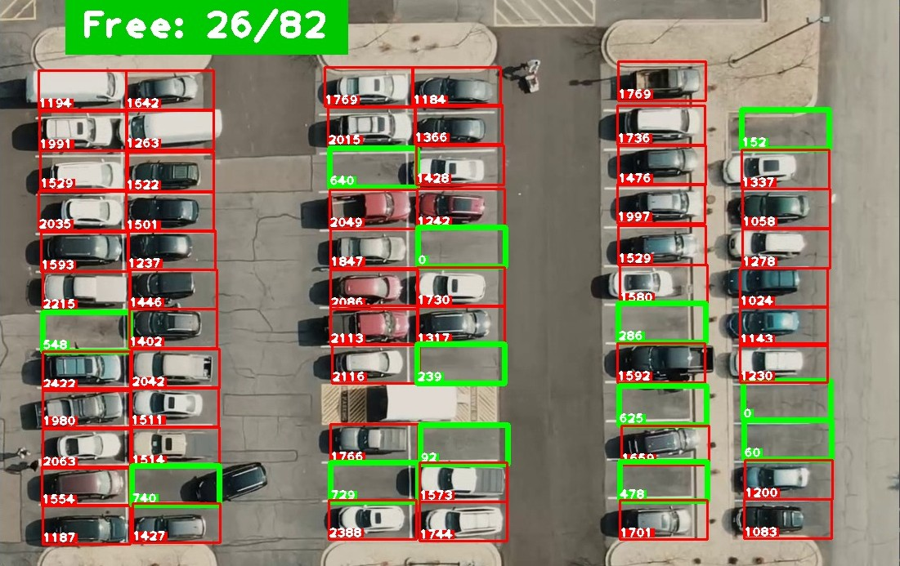
Screenshots
After (Output):

Slide 10
Outcome of Parking Space Counter
Versatile
It is very easy for authorities and vehicle owners to use it. It is also very flexible and does not cause any inconvenience to its users.
Easy to Manage
It will organize the parking areas in a structured manner, it is very easy to manage as well as control and regulate.
Cost-effective
Another advantage that you obtain from
Increased Protection
It will prevent unauthorized access to parking lots, as a result, car owners will have increased confidence that their cars are well protected.
having an effective parking management
system is the cost. Because it runs on low manpower, you save more money.

Slide 11
Conclusion
Due to the rapid increase in urban population and unplanned urbanization, there is a decrement in the number of urban parking spaces and an increment in traffic congestion. As a result, smart parking becomes the subject of interest for both researchers and urban planners. Hence Parking Space counters will act as a major part of smart parking systems.

Slide 12
Thank You

